Slide 1

AI-Powered Image De-Aging: A Technical Exploration
AJAY KASU
U01842639
Course : CS-668
PACE university
ak24455n@pace.edu
https://github.com/AjayKasu1

Slide 2
Targeted Problem: Addressing the Challenge of Realistically De-Aging Facial Images: Achieving Youthful Transformation Without Compromising Realism and Cohesion.
Research Question: How does the integration of facial landmarks enhance the precision of image de-aging?
How can AI-powered image de-aging be effectively applied in the entertainment industry, such as movies and TV shows?
In what ways can de-aging technology assist in forensic analysis, such as age progression analysis for missing persons?
DATASET: The FG-NET dataset is a publicly available dataset for age estimation and face recognition across ages. It consists of 1,002 images of 82 individuals with ages ranging from 0 to 69 years old.
Motivation behind my de-aging project using deep learning is Advancing Image Editing Technology, Deep Learning Challenges and Meeting Industry Demand.

Slide 3
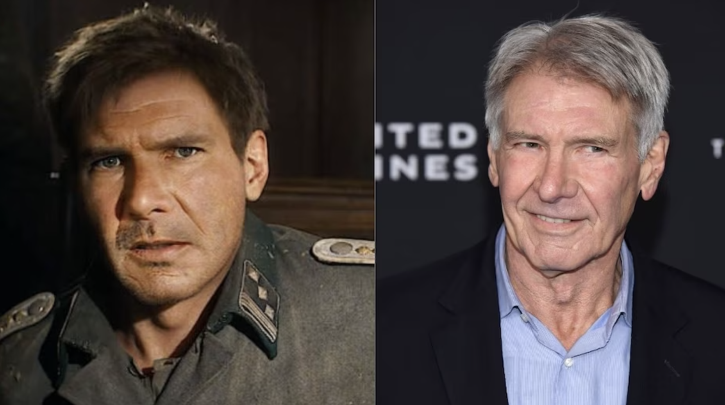

Slide 4
CS 668
Literature Review

Slide 5
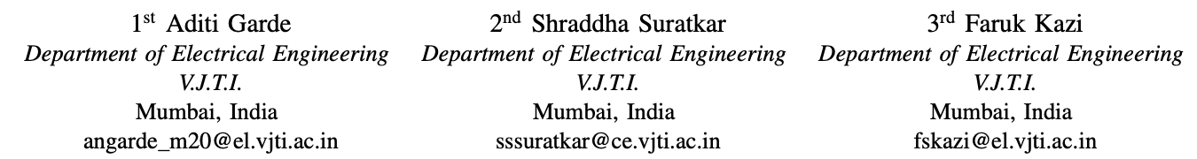
https://ieeexplore.ieee.org/document/10037286
AI Based Deepfake Detection
GOAL: The primary goal of this project is to develop an automated deep fake detection system that utilizes eye blinking patterns to identify the authenticity of videos.
DATASET : Australian Men’s Cricket team pictures.
METHODOLOGY: The project involves utilizing deep learning techniques, specifically Convolutional Neural Networks (CNNs) and Support Vector Machines (SVM), to develop a deep fake detection algorithm. (May involve using Generative Adversarial Networks (GANs) for generating deep fake videos for training purposes).
RESULTS AND LIMITATIONS: The machine learning approach applied to study eye blinking patterns has verified the integrity of Deepfake videos, indicating the potential for reliable Deepfake detection.
While this method contributes to Deepfake detection, ethical considerations surrounding the responsible use of such technology are essential. Ensuring privacy and responsible handling of the data is crucial in the application of these techniques

Slide 6
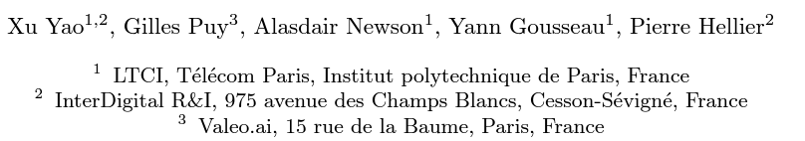
https://arxiv.org/abs/2005.04410
High Resolution Face Age Editing
RESEARCH QUESTION : Can a simplified encoder-decoder architecture effectively perform high-quality face age editing on high-resolution images while preserving key facial attributes?
DATASET : Flickr-Faces-HQ (FFHQ) is a high-quality image dataset of human faces, originally created as a benchmark for generative adversarial networks (GAN)
METHODOLOGY: The methodology involves an encoder-decoder architecture for face age editing, featuring age modulation through a feature modulation block. Training includes an age classifier for age-accurate transformations, an adversarial loss for photorealism, and a reconstruction loss to ensure similarity to the input.
Results include the performance of the encoder-decoder model, image quality, age transformations, and ethical considerations. Limitations may encompass addressing potential visual artifacts, refining age selection criteria, and the need for a substantial high-resolution dataset

Slide 7

https://ieeexplore.ieee.org/document/9464699
UniFaceGAN: A Unified Framework for Temporally Consistent Facial Video Editing
RESEARCH QUESTION : How can facial video editing be improved to handle both face swapping and face reenactment simultaneously?
DATASET : The Voxceleb2 dataset is adopted for this research, comprising over a million utterances from more than 6,000 speakers. The dataset serves as a comprehensive source for training and evaluating deep learning models.
METHODOLOGY: Conducting multi-task training on the Voxceleb2 dataset. Setting the intra-video sampling rate (σ) to 0.5. Using five quantitative metrics for evaluation: Frechet-inception distance (FID), structured similarity (SSIM), identity error (Eid), pose error (Epose), and expression error (Eexp).
RESULTS AND LIMITATIONS: Introduces UniFaceGAN, a unified framework for video portrait manipulation tasks. Dynamic Training Sample Selection enhances multi-task training. Novel 3D temporal loss ensures visually consistent synthesized videos. Region-Aware Conditional Normalization (RCN) layer improves facial feature blending. UniFaceGAN outperforms existing methods across tasks.
Limited exploration beyond the Voxceleb2 dataset. Complexity of proposed components may pose practical challenges.

Slide 8
DATASET
The FG-NET(Face and Gesture Recognition Network) dataset is a publicly available dataset for age estimation and face recognition across ages. It consists of 1,002 images of 82 individuals with ages ranging from 2 to 69 years old.
An age gap of up to 45 years for some individuals. Facial landmark annotations for each image (68 points). It is often used for face verification across large age gaps. The dataset contains images ranging from child/young to adult/old.

Slide 9
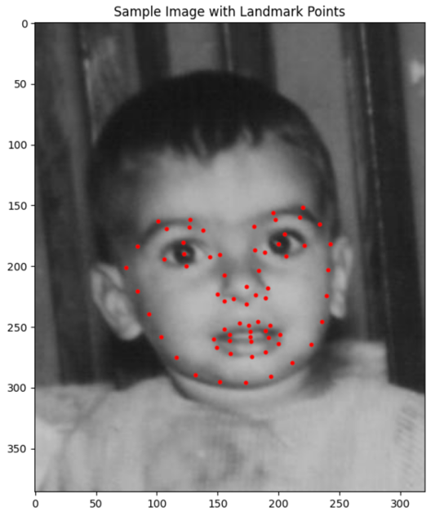
EDA
Sample image with landmark points

Slide 10
Methodology:
Data Preprocessing:
Crop and align facial images for consistency.
Annotate facial landmarks for precise alignment during training.
Feature Extraction:
Utilize the ResNet50 architecture to extract high-level features from facial images.
Fine-tune the pre-trained model on the annotated dataset for improved age-related feature capture.
Age Range Categorization:
Define age ranges for supervised learning, categorizing individuals into "young" and "old" groups based on ground truth ages.
Create labels for age categories.
Supervised Learning with Random Forest (RF):
Train a Random Forest classifier using extracted features as input and age categories as labels.
Evaluate the model's performance on a separate validation set.
CycleGAN Training:
Implement a CycleGAN architecture for bidirectional image translation, focusing on de-aging.
Prepare paired training data, consisting of original images and corresponding age-decreased versions.
Train the CycleGAN model to learn the mapping between young and old faces.
Model Evaluation:
Evaluate the de-aging performance of the CycleGAN model using a separate test set.
Use qualitative measures like visual inspection and quantitative metrics such as Structural Similarity Index (SSI) and perceptual metrics.

Slide 11
Key Components of the Project
CycleGAN Architecture:
Utilizing a CycleGAN architecture with dual generators and discriminators for bidirectional transformation between young and old faces.
Employing cycle consistency to ensure that the transformation is reversible, preserving facial features in both directions.
Facial Landmarks Integration:
Leveraging facial landmarks for precise alignment during the de-aging process.
Improving the handling of individual facial expressions and distinctive features.

Slide 12
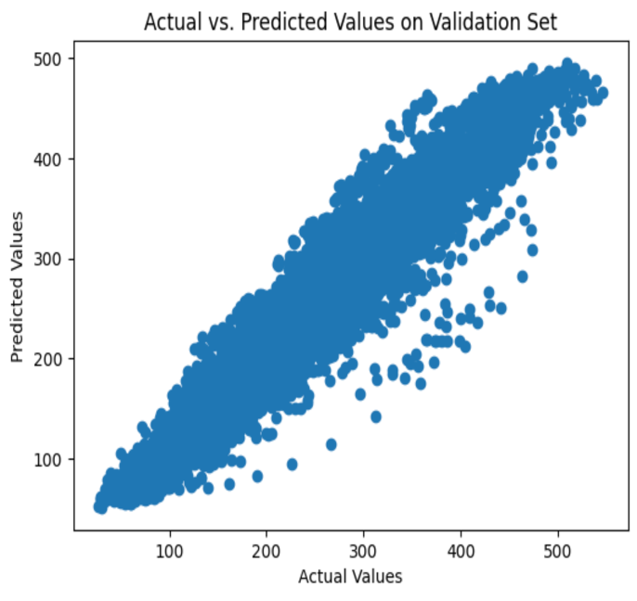
RESULTS
Random forest model's performance on
a separate validation set.

Slide 13
CONCLUSION AND FUTURE WORK
In my exploration of AI-powered image de-aging, I have successfully utilized ResNet50 for feature extraction and Random Forest for accurate age categorization. The integration of CycleGAN, although transformative, is still in progress and holds the promise of producing realistic de-aged images.
As I conclude this phase, the project signifies a promising start rather than an endpoint. Future work involves refining de-aging quality, venturing into video de-aging, and addressing ethical considerations. This exploration reflects a commitment to pushing AI boundaries, emphasizing both technical innovation and ethical responsibility.

Slide 14
REFERENCES
Liu, S., Sun, Y., Zhu, D., Bao, R., Wang, W., Shu, X., Yan, S., & Yan, S. (Year). Face Aging with Contextual Generative Adversarial Nets.
High Resolution Face Age Editing Xu Yao, Gilles Puy, Alasdair Newson, Yann Gousseau, Pierre Hellier https://arxiv.org/abs/2005.04410v1
Zhu, J.-Y., Park, T., Isola, P., & Efros, A. A. (2017). Unpaired Image-to-Image Translation using Cycle-Consistent Adversarial Networks. In Computer Vision and Pattern Recognition (CVPR).
Suo, J., Zhu, S.-C., Shan, S., & Chen, X. (2009). A Compositional and Dynamic Model for Face Aging. Journal of LaTeX Class Files, Volume number(Issue number), Page range. DOI/Publisher.

Slide 15
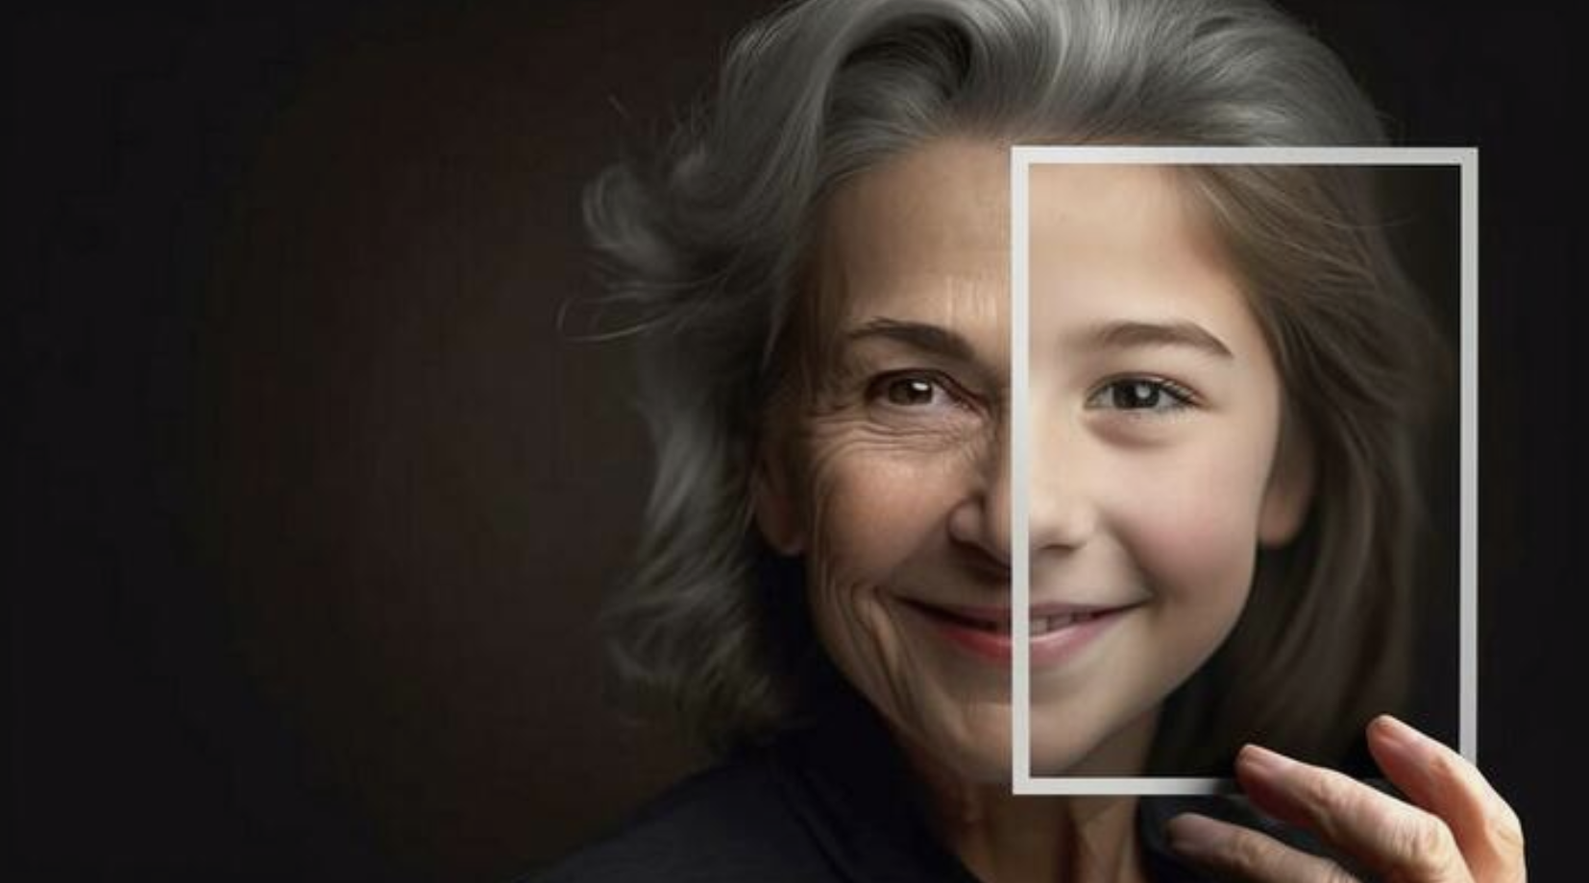
THANK YOU

